Slide 1
Step 1: Choose an Ad
Example of Text Only Ad
What a Fabulous Performance Rebecca! We’re SO Proud of you! - Love, Mom, Dad, Sam, & Kelsey
Example of 1/8 page Ad
Albert,
you convinced us you were a Rabbi!
- Love, Grandma and Grandpa
Example of 1/4 page Ad
Sam,
No-one can tell a story like you!
Love, Mom and Dad
Example of 1/2 page Ad
You Ruled,
Mitch!
You put so much hard work into your role, and it showed!
Next Stop, Broadway!
- Love, Evan & Patrice.

Slide 2
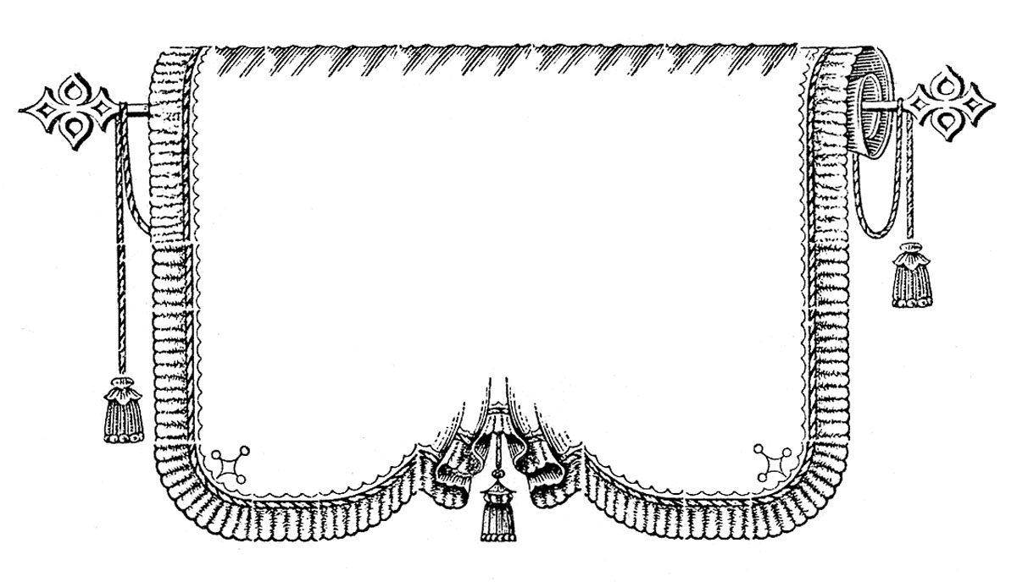
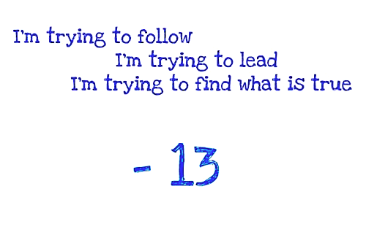
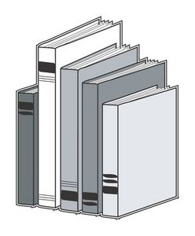
Step 2: Choose a Graphic
1
2
3
4
5
6
7
8
9
10
11
12

